Slide 1
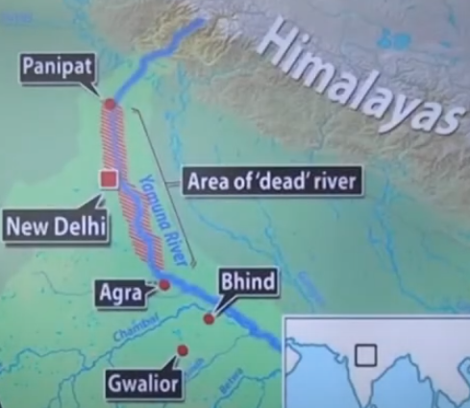
Case Study of Water Pollution
India most polluted river is Yamuna

Slide 2
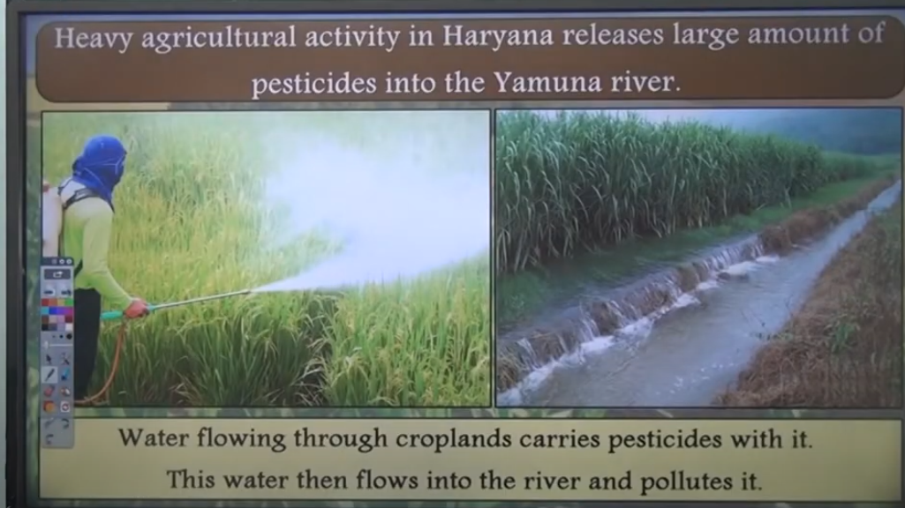

Slide 3
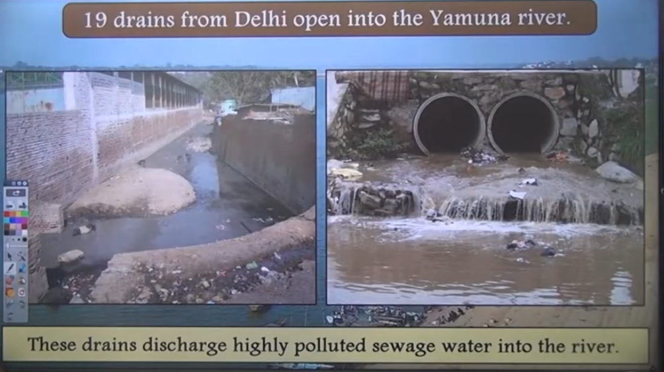

Slide 4
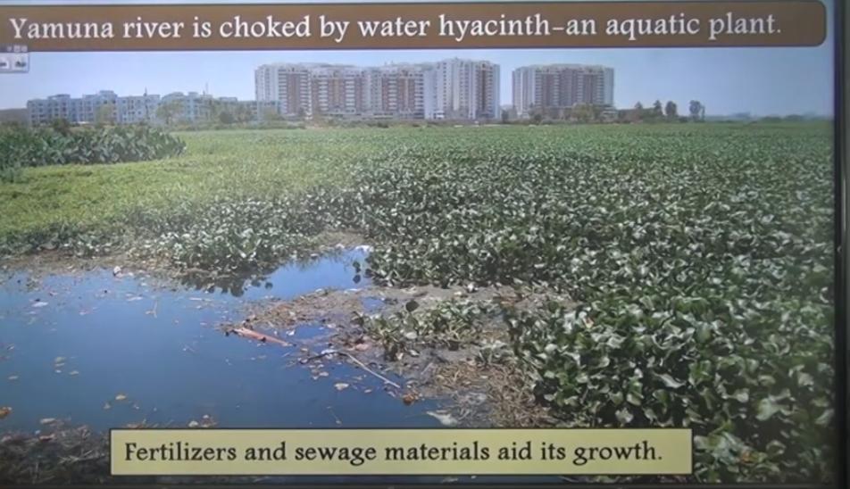

Slide 5
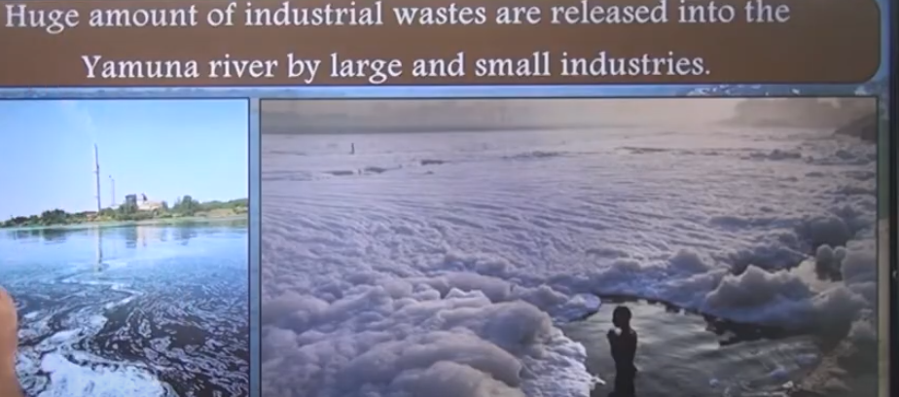

Slide 6
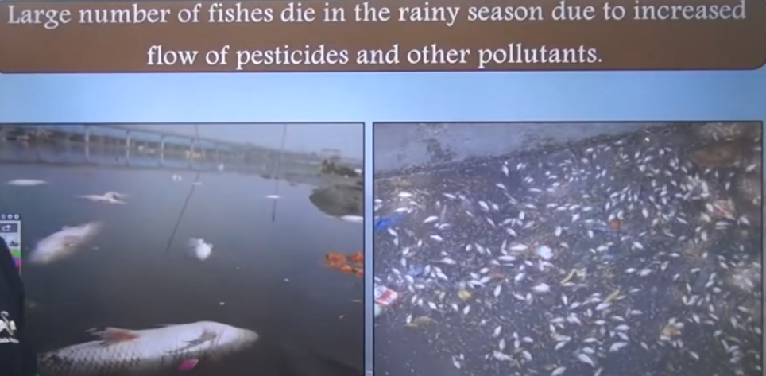

Slide 7
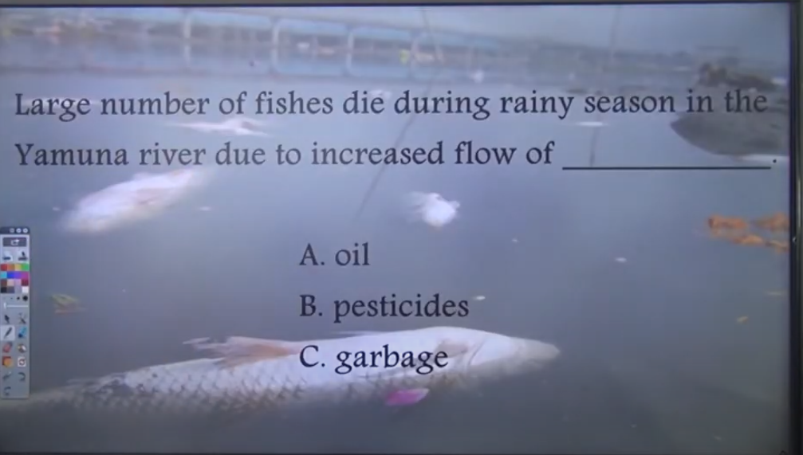

Slide 8
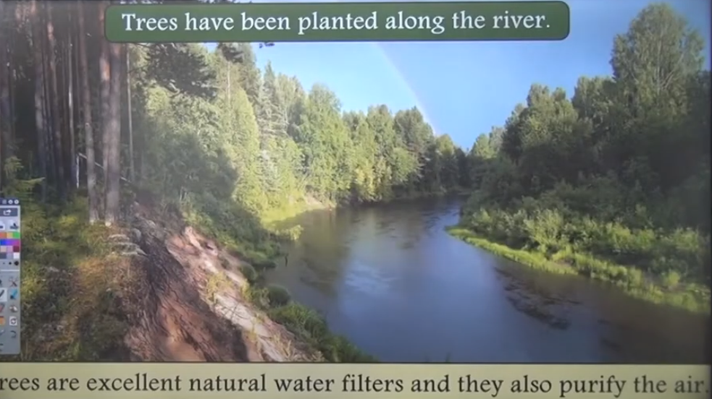

Slide 9
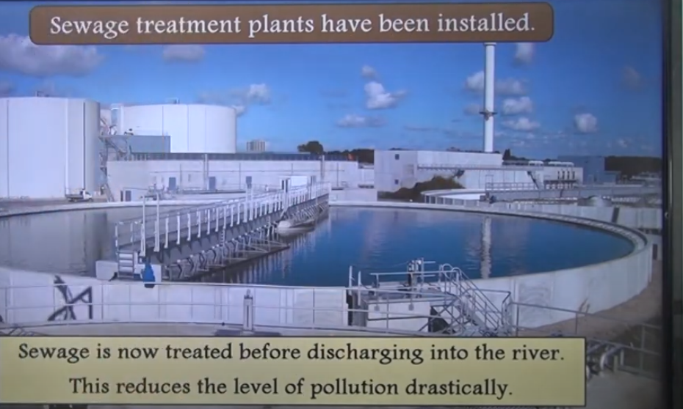

Slide 10
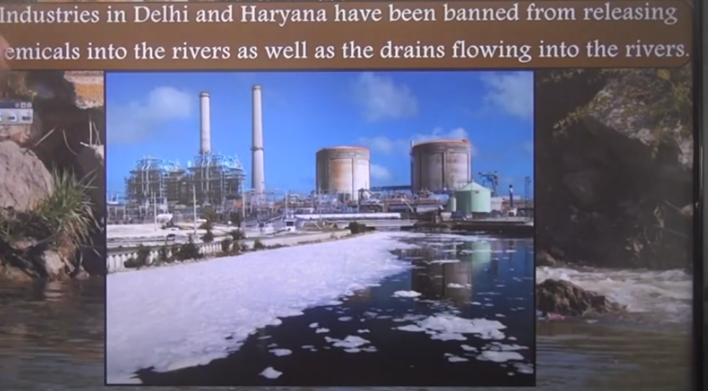

Slide 11
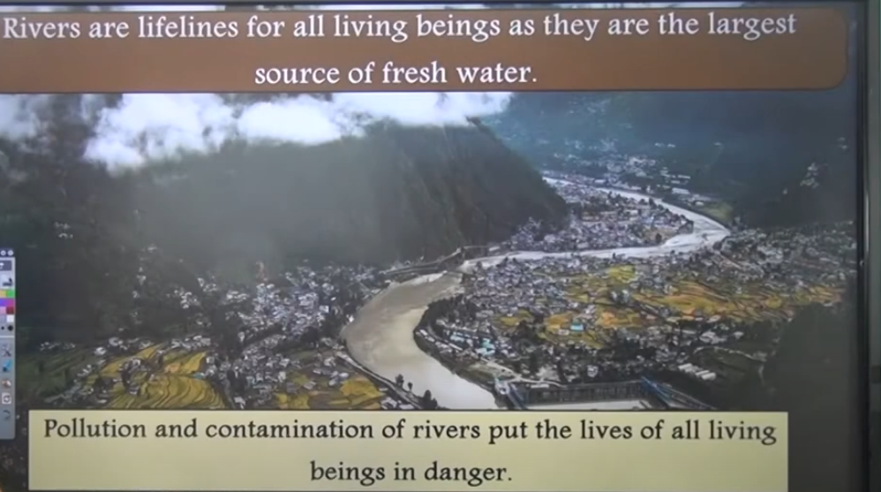

Slide 12
Case Study on Environmental Management in Water Resource Management
Case Study: Integrated Water Resource Management in the Ganges River Basin
Introduction
The Ganges River Basin, one of the largest river systems in the world, supports over 600 million people across India, Nepal, Bangladesh, and China. Due to rapid industrialization, urbanization, and agricultural expansion, the ecosystem has suffered from pollution, water scarcity, and biodiversity loss. Integrated Water Resource Management (IWRM) has been implemented to address these environmental challenges and ensure sustainable development.
Problem Statement
The Ganges ecosystem faces multiple environmental challenges, including:
High levels of pollution due to industrial and domestic waste.
Overextraction of water for agriculture and urban use.
Loss of aquatic biodiversity, including the endangered Ganges river dolphin.
Climate change impacts, such as erratic monsoons and glacier melting in the Himalayas.

Slide 13
Methodology
The environmental management approach involved:
Pollution Control Measures: Implementation of sewage treatment plants (STPs) and industrial effluent monitoring systems.
Community Involvement: Awareness programs and local participation in river-cleaning projects.
Water Conservation Strategies: Rainwater harvesting, watershed management, and afforestation along riverbanks.
Government Initiatives: Programs like the Namami Gange Mission in India, which focuses on cleaning and rejuvenating the river.
Technology & Data Analysis: Use of Geographic Information Systems (GIS) and remote sensing for monitoring water quality and land-use changes.

Slide 14
Key Findings
Implementation of STPs significantly reduced untreated sewage entering the river.
Community-led initiatives like the “Save Ganga Movement” improved local participation.
Riparian vegetation restoration contributed to biodiversity conservation.
Reduction in industrial pollution improved aquatic life, including increased sightings of the Ganges river dolphin.
Implications of Environmental Management
Ecological Impact: Improved water quality and biodiversity conservation.
Economic Benefits: Sustainable fishing and ecotourism opportunities.
Social Benefits: Better public health due to cleaner water sources.
Policy Framework: Need for stronger regulatory enforcement and cross-border cooperation among nations sharing the river basin.
Conclusion
The Ganges River Basin case study highlights the importance of integrated environmental management approaches in ecosystem conservation. By combining government policies, technological advancements, and community involvement, sustainable environmental practices can be achieved. However, continuous monitoring and adaptive strategies are essential to counter future environmental challenges.
Would you like me to tailor this case study for a specific academic or research purpose?

Slide 15
Case Study: Environmental Management in Overpopulated Regions
Introduction
Overpopulation is a significant global challenge that leads to environmental degradation, resource depletion, and increased pollution. Effective environmental management strategies are crucial to mitigating these issues. This case study focuses on India, one of the most densely populated countries, examining the impact of overpopulation on the environment and sustainable management strategies.
Background
India’s population exceeded 1.4 billion in 2023, making it the most populous country. Rapid urbanization and industrialization have contributed to severe environmental issues, including:
Deforestation due to land clearing for housing and agriculture.
Water scarcity and contamination from excessive groundwater extraction and pollution.
Air pollution caused by vehicular emissions, industrial activities, and biomass burning.
Waste management crisis due to increased solid and plastic waste.
Key Environmental Challenges
1. Air Pollution in Delhi
Delhi is one of the most polluted cities in the world, with PM2.5 levels exceeding safe limits. The primary causes include:
Vehicular emissions
Industrial activities
Crop burning in nearby states
Construction dust

Slide 16
2. Water Scarcity in Chennai
Chennai faced a Day Zero water crisis in 2019 due to:
Over-extraction of ground water
Poor rainwater harvesting implementation
Encroachment of water bodies
3. Waste Management in Mumbai
Mumbai generates over 11,000 tons of waste daily, leading to overflowing landfills such as Deonar Dumping Ground, causing:
Groundwater contamination
Air pollution from landfill fires
Environmental Management Strategies
1. Sustainable Urban Planning
Developing green buildings with efficient waste and water management systems.
Expanding public transportation to reduce vehicular emissions.
2. Water Conservation Programs
Implementation of rainwater harvesting in urban areas.
Restoration of lakes and water bodies to increase groundwater recharge.

Slide 17
3. Waste Management Solutions
Promoting waste segregation at the source (wet and dry waste).
Encouraging recycling and composting to reduce landfill waste.
Banning single-use plastics to control plastic pollution.
4. Reforestation and Afforestation
Large-scale tree-planting campaigns such as "Mission Green India".
Creating urban green spaces to improve air quality.
5. Policy Interventions
Implementation of the Odd-Even Vehicle Rule in Delhi to control air pollution.
Strict enforcement of industrial pollution control measures.
Government initiatives like Namami Gange to clean the Ganges River.

Slide 18
Impact and Results
Delhi’s air quality improved by 15% due to vehicle restrictions and pollution control measures.
Chennai’s rainwater harvesting mandate increased groundwater levels.
Mumbai’s waste-to-energy plants reduced landfill dependency by 20%.
Conclusion
Overpopulation intensifies environmental challenges, but sustainable environmental management strategies can mitigate the impact. Effective urban planning, policy interventions, and community participation are key to balancing population growth with environmental conservation.

Slide 19
Case Study: Environmental Management in Air Pollution Control
Air pollution is a significant environmental challenge affecting human health, biodiversity, and climate. Effective environmental management strategies are essential for mitigating air pollution and ensuring sustainable development. This case study examines air pollution management in Delhi, India, which has faced severe air quality issues due to rapid urbanization, industrialization, and vehicular emissions.
Background: Air Pollution in Delhi
Delhi consistently ranks among the most polluted cities in the world, with PM2.5 levels often exceeding safe limits set by the WHO. The primary sources of air pollution include:
Vehicular emissions (contributing ~40%)
Industrial pollution
Construction dust
Biomass burning and stubble burning (especially in neighboring states)
Waste burning
Meteorological factors (such as winter inversion trapping pollutants)
The pollution crisis in Delhi worsens during the winter due to temperature inversion and burning of crop residues in nearby states like Punjab and Haryana.

Slide 20
Environmental Management Strategies Implemented
1. Regulatory Measures
Implementation of the Graded Response Action Plan (GRAP):
A set of emergency measures activated based on air quality levels.
Includes restrictions on construction, vehicular movement, and industrial operations.
Odd-Even Vehicle Rule:
Implemented during peak pollution periods, restricting vehicles based on license plate numbers.
2. Technology-Based Solutions
Smog Towers: Large air-purifying structures installed in key locations to reduce airborne pollutants.
CNG and Electric Vehicles: Encouragement of cleaner fuel alternatives.
Piped Natural Gas (PNG): Transition from coal-based industries to natural gas

Slide 21
3. Public Awareness and Participation
"Red Light On, Gaadi Off" Campaign: Encouraging motorists to switch off engines at traffic signals.
Ban on Firecrackers: To reduce pollution during festive seasons.
4. Green Initiatives
Mass tree plantation drives to enhance carbon sequestration.
Introduction of Green War Rooms to monitor and coordinate air quality improvement actions.
5. Monitoring and Data-Driven Policies
Real-Time Air Quality Index (AQI) Monitoring:
Government agencies continuously track air quality and publish real-time data for public awareness.
Use of Satellite Data and AI:
To predict pollution levels and plan interventions in advance.

Slide 22
Outcomes and Challenges
Successes
Reduction in SO2 and CO levels due to cleaner fuel adoption.
Increased public awareness and involvement in air pollution control.
Expansion of Delhi Metro and public transport reducing dependency on private vehicles.
Challenges
Ineffectiveness of short-term solutions: Measures like smog towers have limited impact on overall air quality.
Political and interstate coordination issues: Stubble burning remains a major concern.
Lack of strict enforcement: Despite regulations, violations persist, leading to recurring pollution spikes.

